Slide 1
DATASTRUCTURES
IN C
MODULE –
SESSION-

Slide 2
Binary Search Tree:
Binary Search tree can be defined as a class of binary trees, in which the nodes are arranged in a specific order. This is also called ordered binary tree.
In a binary search tree, the value of all the nodes in the left sub-tree is less than the value of the root.
Similarly, value of all the nodes in the right sub-tree is greater than or equal to the value of the root.
This rule will be recursively applied to all the left and right sub-trees of the root.

Slide 3
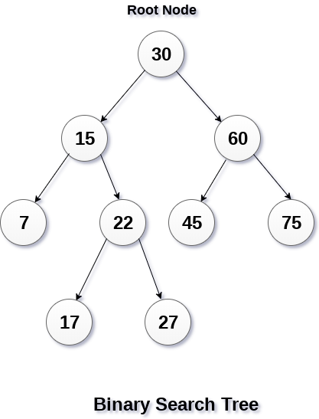
Advantages of using binary search tree
The binary search tree is considered as efficient data structure in compare to arrays and linked lists. In searching process, it removes half sub-tree at every step. Searching for an element in a binary search tree takes o(log₂n) time. In worst case, the time it takes to search an element is 0(n).
It also speed up the insertion and deletion operations as compare to that in array and linked list.

Slide 4
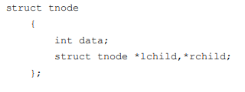
Routine for BST:

Slide 5
Create the binary search tree using the following data elements.
43, 10, 79, 90, 12, 54, 11, 9, 50
Insert 43 into the tree as the root of the tree.
Read the next element, if it is lesser than the root node element, insert it as the root of the left sub-tree.
Otherwise, insert it as the root of the right of the right sub-tree.
The process of creating BST by using the given elements, is shown in the image below.

Slide 6
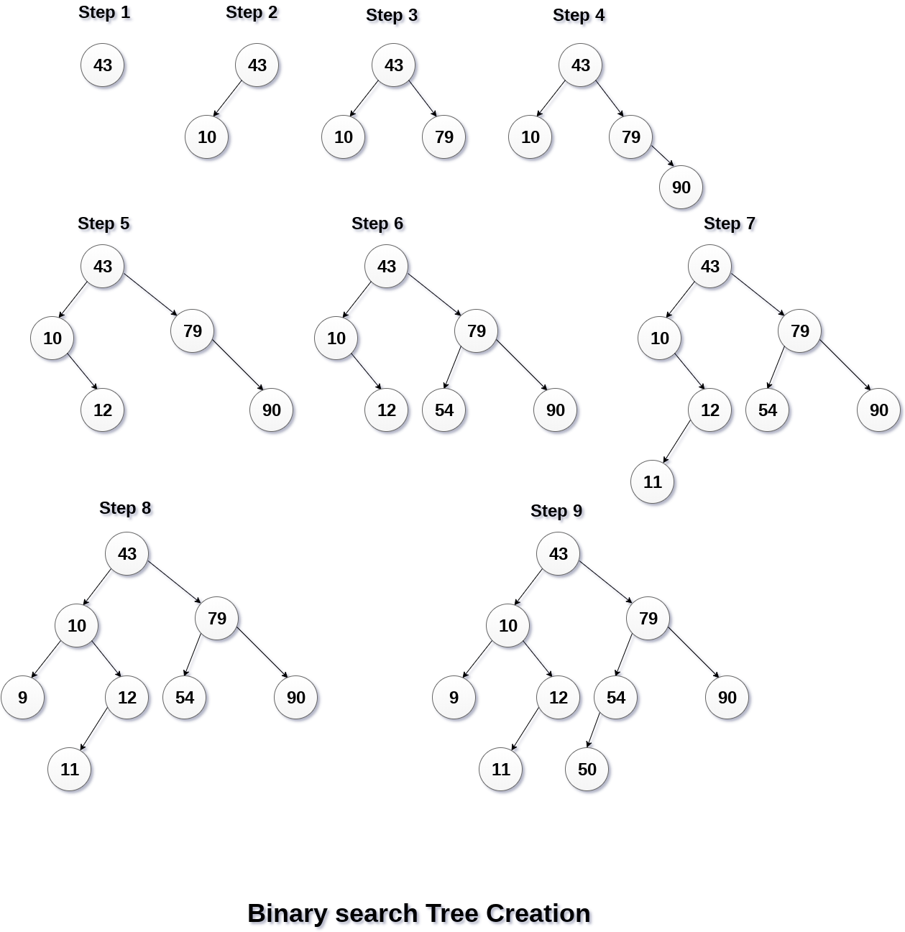

Slide 7
Operations:
Insertion Operation in Binary Search Tree
To insert the element “X” into the tree
Check the element with the root node T
If it is less than the root
Traverse the left subtree recursively until it reaches the T→Left equal to NULL.
Then place the X in T→Left
If it is greater than the root Traverse the right subtree recursively until it reaches the T→Right equal to NULL.
Then place the X in T→Right

Slide 8
Insertion routine for binary search tree
SearchTree Insert(int X,SearchTree T)
{
if (T==NULL)
{
T=malloc(sizeof(Struct treeNode));
If(T!=NULL)
{
T→Element=X;
T→Left=NULL;
T→Right=NULL;
}
}
else
if(X<T→Element)
T→Left=Insert(X,T→Left);
else
if(X>T→Element)
T→Right=Insert(X,T→Left);
return T;
}

Slide 9
Find routine for binary search tree
int Find(int X,SearchTree T)
{
if(T==NULL)
return NULL;
if(X<T→Element)
return Find(X,T→Left);
else
if(X>T→Element)
return Find(X,T→Right);
else
return T;
}

Slide 12
Deletion Operation in Binary Search Tree
Deletion operation is the complex operation in the binary search tree.
There are three possibilities in deletion process.
Case1: Node to be deleted is a leaf node (or) No children
Case2: Node with one child
Case3: Node with two children

Slide 13
Delete routine for binary search tree
SearchTree Delete (ElementType X, SearchTree T)
{
Position TmpCell;
If(T==NULL)
Error(“Element not found”);
else
if( X<T→Element)
T→Left=Delete(X,T→Left);
else
if( X>T→Element)
T→Right=Delete(X,T→Right);
else
if(T→Left && T→Right)
{
TmpCell=FindMin(T→Right);
T→Element=TmpCell→Elemnent;
T→ight=Delete(T→Element,T→Right);
}
else
{
TmpCell=T;
if(T→Left==NULL)
T=T→Right;
else if(t→Right==NULL)
T=T→Left;
free(TmpCell);
}
return T;
}

Slide 14
Thank you

